Slide 1
BRAIN TUMOR DETECTION

Slide 2
CONTENTS
ABSTRACT
DATASET
OBJECTIVES
PROPOSED METHODOLOGY
RESULTS
CONCLUSION

Slide 3
ABSTRACT
Brain tumour is one of the most dangerous diseases which require early and accurately detection methods.
Now most detection and diagnosis methods depend on decision of neuro specialists and radiologist for image evaluation which is possible to human errors and time consuming.
The main porose of this project is to build a robust CNN model that can classify if the subject has a tumour or not based on Brain MRI scan images with an acceptable accuracy for medical grade application.

Slide 4
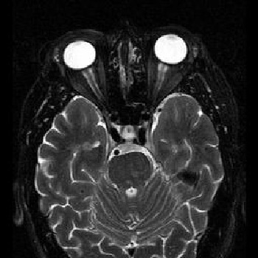
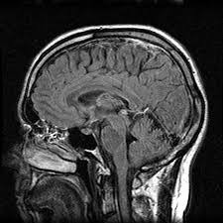
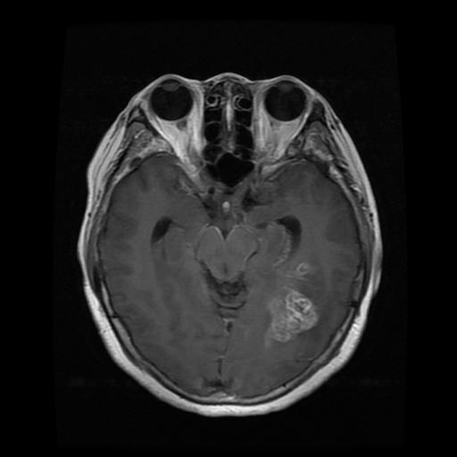
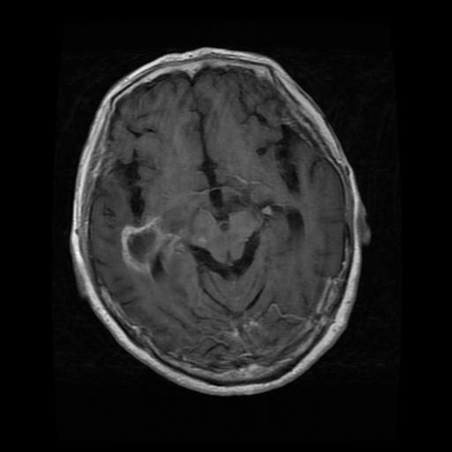
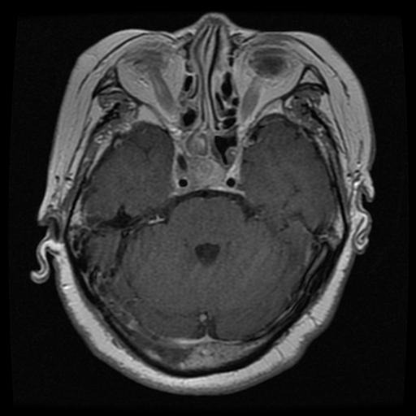
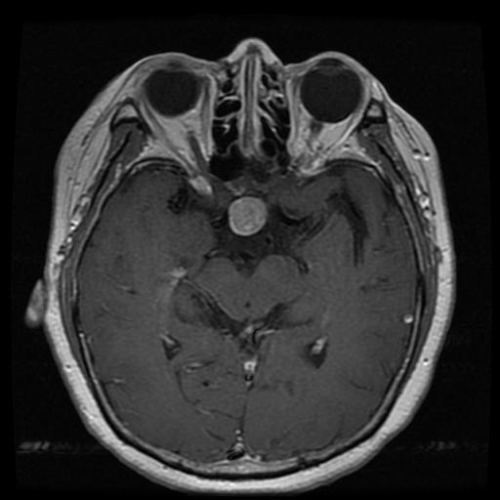
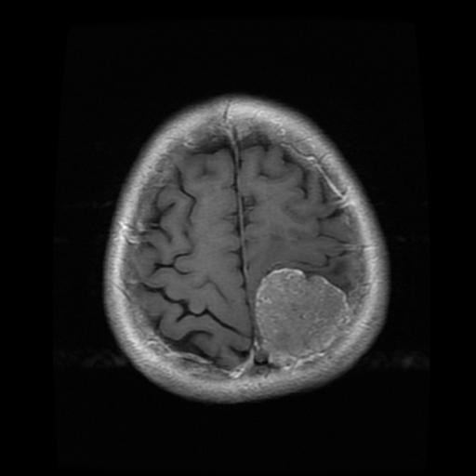
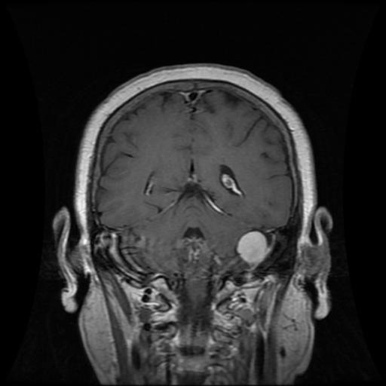
SOME IMAGES FROM DATASET
NO TUMOUR GLIOMA TUMOUR
PITUITARY TUMOUR MENINGIOMA TUMOUR

Slide 5
OBJECTIVES
The definition of a good model for us was high test and validation accuracy.
To establish baseline ,we made use of a 4 layer MLP. We then moved on to SVM with( HOG )for feature extraction.
Next came CNNs of varying sizes with parameter tuning . We tried deep CNNs with multiple rounds of convolution and max pooling with a FCN at the end.
Along similar lines to improve results , we tried transfer learning using ResNet, VGG16 and VGG 19.

Slide 6
PROPOSED METHADOLOGY
We found VGG16 gave the best result for the chosen parameters(Training/Val accuracy/test accuracy)
We flattened the output of the model and added Dropout and a Dense
Layer .
VGG 16 is a Convolutional neural network model that used for image recognition .Its unique in that it has only 16 layers that have weights ,as opposed to relying on a large number of hyper parameters .
Its considered one of the best vision model architectures.

Slide 7
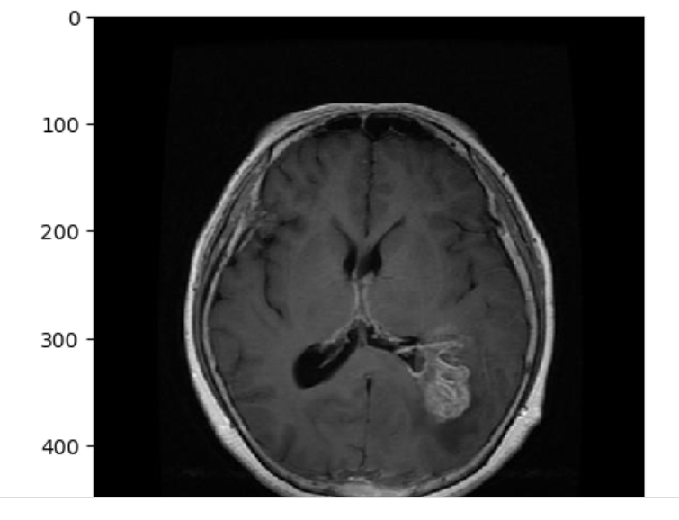
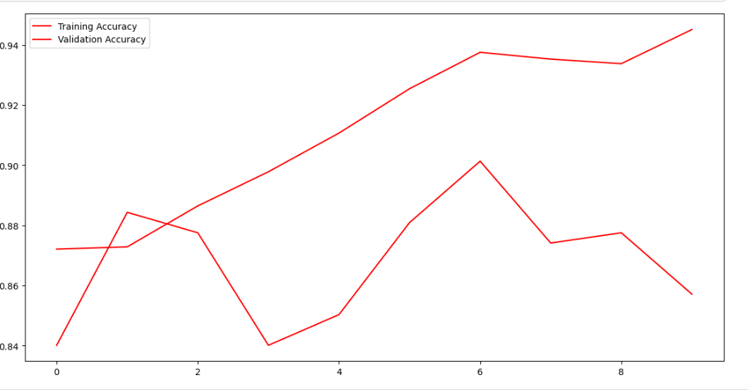
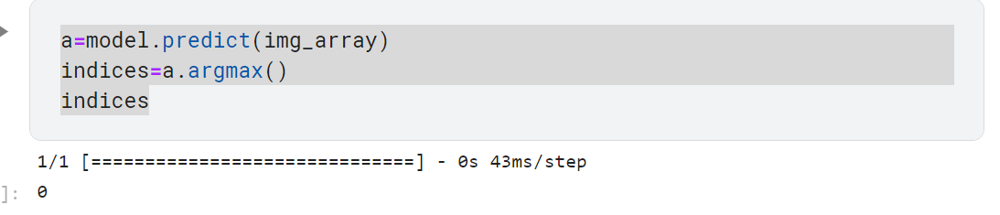
RESULTS

Slide 8
CONCLUSION
We were able to create and train a model that gave us very high accuracy on unseen data using relatively high input.
Proper image processing based on the problem statement is what separates a good model from a bad one
Transfer learning can simplify even complicated problems with the drawback of computation time

